Slide 1
ITS Executive Steering Committee (ITESC)
Agenda and Materials – December 12, 2017

Slide 2
Agenda
Technology Changes for Spring 2018
B. Montes, D. Vonder Heide
Student System Upgrade
K. Smith
LUHS Upgrade to Workday
J. Sibenaller
ITS Project Portfolio Prioritization
S. Malisch, J. Sibenaller
2

Slide 3
Important Technology Changes Coming This Spring for Faculty
Loyola University Chicago is planning for a series of important technology changes that will occur throughout the spring semester. As service offerings from our product and service providers have evolved over time, these changes are intended to retain technologies that are offering the most desirable and attractive features at the present time, and reduce duplicative technology solutions (and associated costs). Please review the changes listed below to learn about what the change is, the targeted timeline for each change, if and how you might be affected, and what you may need to do to prepare for the change.
In short the following changes will occur beginning December 2017 through May 2018:
Microsoft OneDrive will replace Box as Loyola’s cloud-based storage solution. Go here to learn more about this change.
Panopto will replace Kaltura as Loyola’s video repository and streaming service. Go here to learn more about this change.
Zoom will replace Adobe Connect as Loyola’s Web Conferencing and Online Synchronous Classroom solution. Go here to learn more about this change.
Sakai course sites greater than 2 years old will be deleted and a regular practice of deleting course sites greater than two years old will be instituted. Go here to learn more about this change.
3

Slide 4
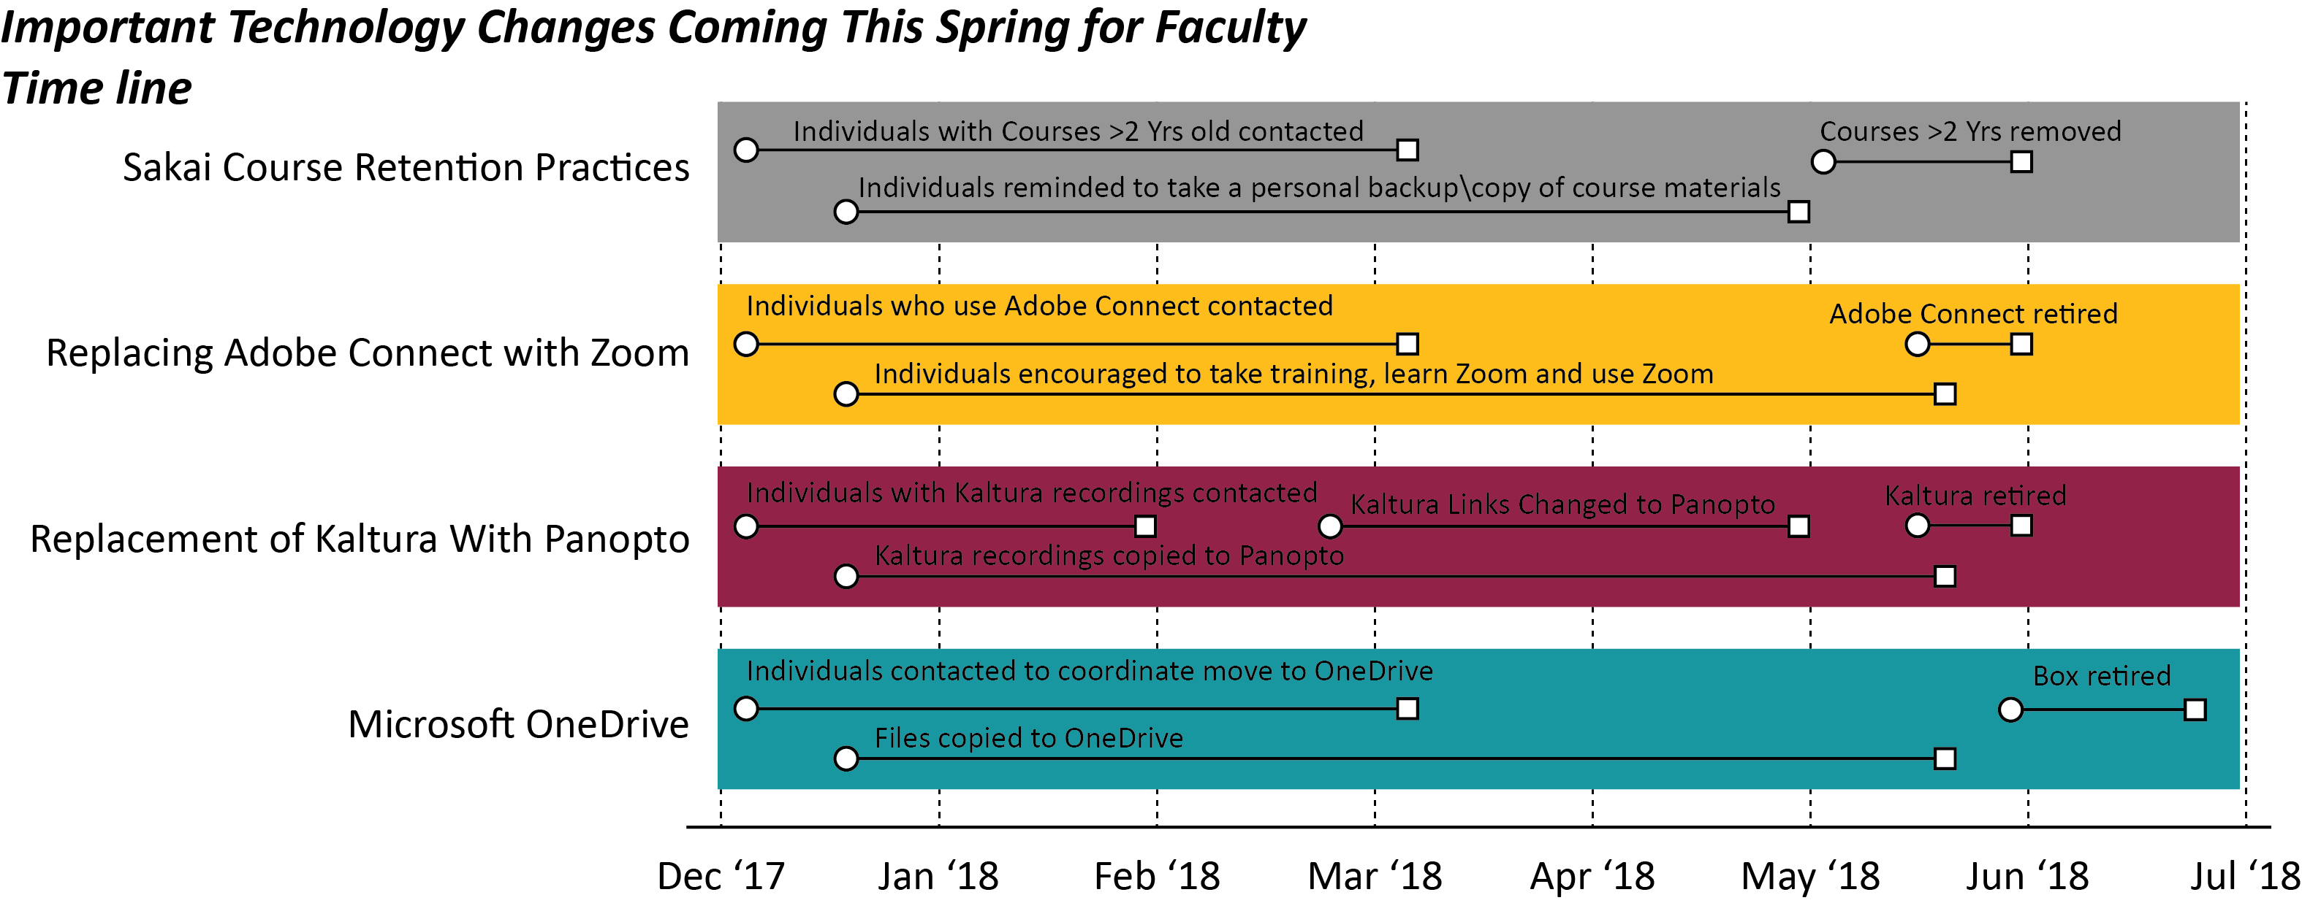
Review and Communication
Presented to ITESC – September 20th
Presented to Council of Deans – October 17th
Presented to Academic Technologies Committee (ATC) – November 8th
Presented to Coordinating Committee for Blended and Online Learning (CCBOL) – November 29th
Email to all faculty & Posted on ITS Websites – December 8th
4

Slide 5
Agenda
Technology Changes for Spring 2018
B. Montes, D. Vonder Heide
Student System Upgrade
K. Smith
LUHS Upgrade to Workday
J. Sibenaller
ITS Project Portfolio Prioritization
S. Malisch, J. Sibenaller
5

Slide 6
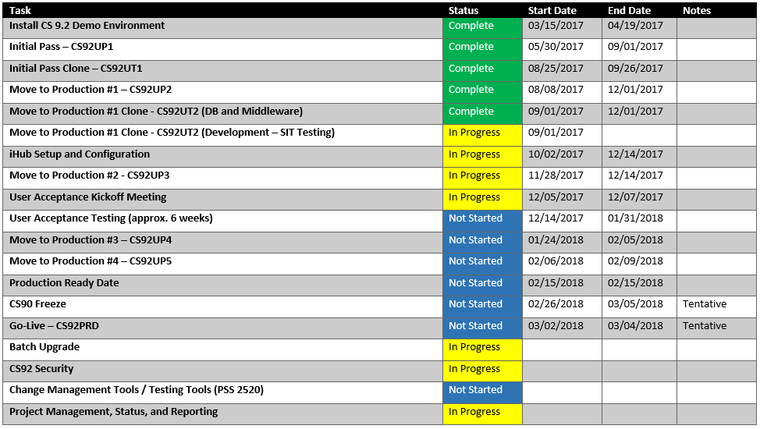
CS 9.2 Upgrade Milestones
6

Slide 7
Agenda
Technology Changes for Spring 2018
B. Montes, D. Vonder Heide
Student System Upgrade
K. Smith
LUHS Upgrade to Workday
J. Sibenaller
ITS Project Portfolio Prioritization
S. Malisch, J. Sibenaller
7

Slide 8
LUHS Upgrade to Workday-Project Risks and Remaining Tasks for LUC
Project Health
The project health is critical or red. We have multiple concerns, high risk and we are off target.
Issues/Risks
Interfaces are still being tested.
Data mapping and translation discussions are ongoing.
We are also missing several data mappers, specifically for ID’s, departments and earnings/deduction codes.
HSD is awaiting clarification on issues with two of the data files.
Training of LUC staff in Finance & HR is ongoing.
Our understanding of the test data is unclear or it is partially incomplete.
If LUHS goes live on 12/24 we will need to keep Trinity focused on completing our remaining project tasks before they work on/move on to their next project. They may also will be distracted by post live support items.
Manual processes are being suggested in lieu of automated solutions.
8

Slide 9
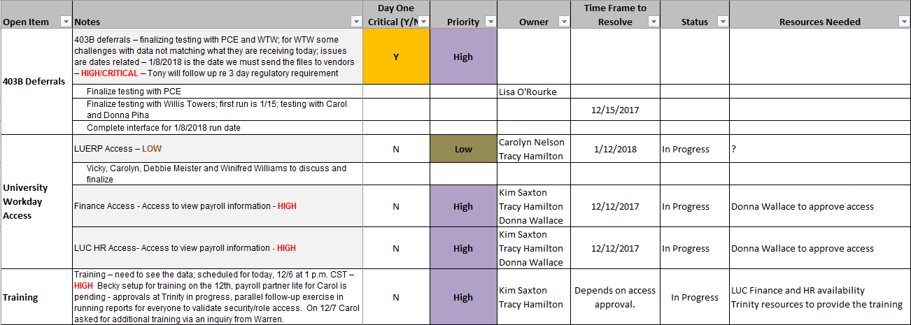
LUHS Upgrade to Workday-Project Risks and Remaining Tasks for LUC
9

Slide 10
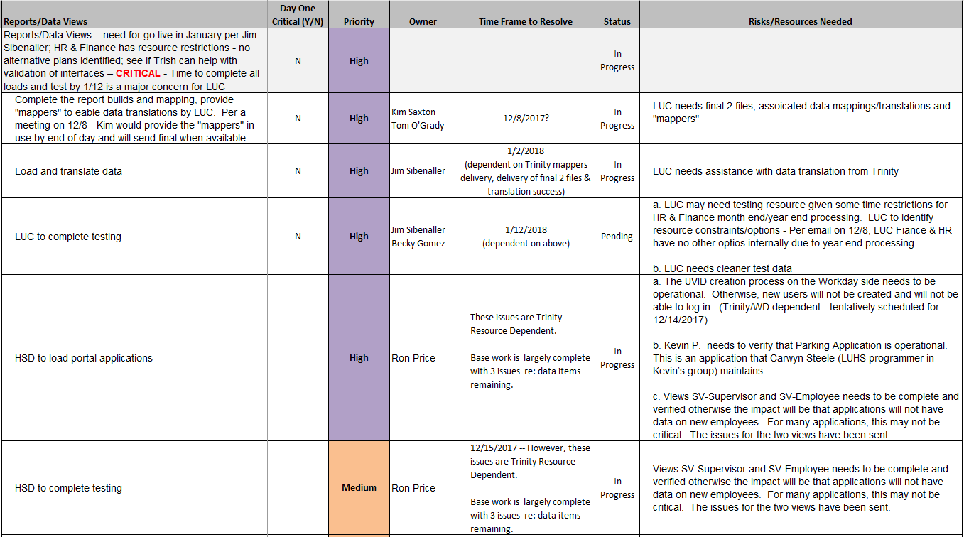
LUHS Upgrade to Workday-Project Risks and Remaining Tasks for LUC
10

Slide 11
Agenda
Technology Changes for Spring 2018
B. Montes, D. Vonder Heide
Student System Upgrade
K. Smith
LUHS Upgrade to Workday
J. Sibenaller
ITS Project Portfolio Prioritization
S. Malisch, J. Sibenaller
11

Slide 12
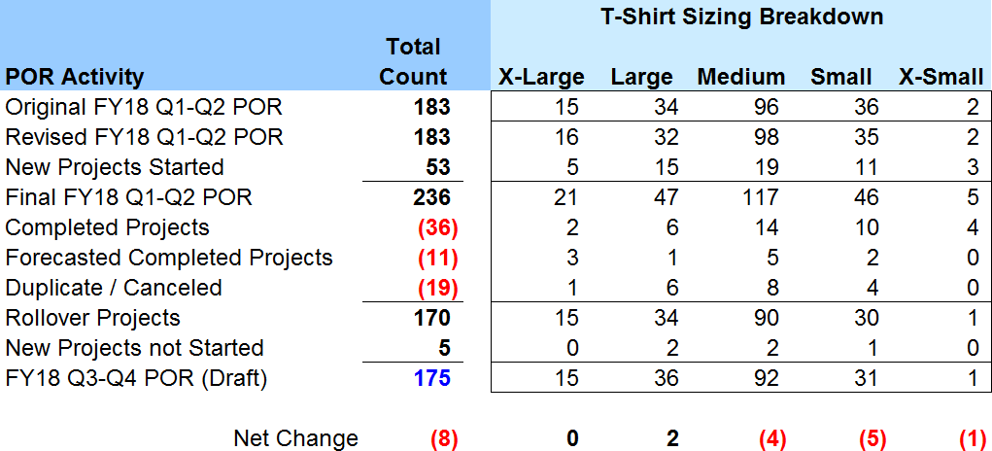
Plan of Record Tracking
12

Slide 13
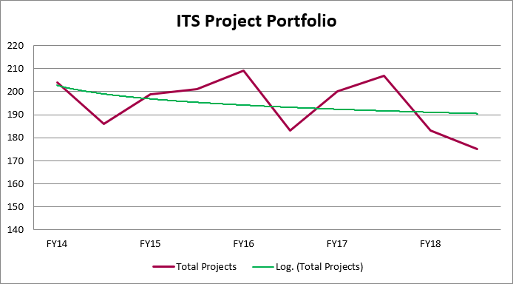
Project Sizing Trend
13

Slide 14
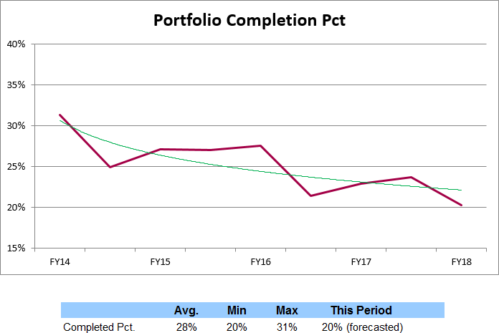
Completed Project Forecast
47 projects forecast completed this period
14

Slide 15
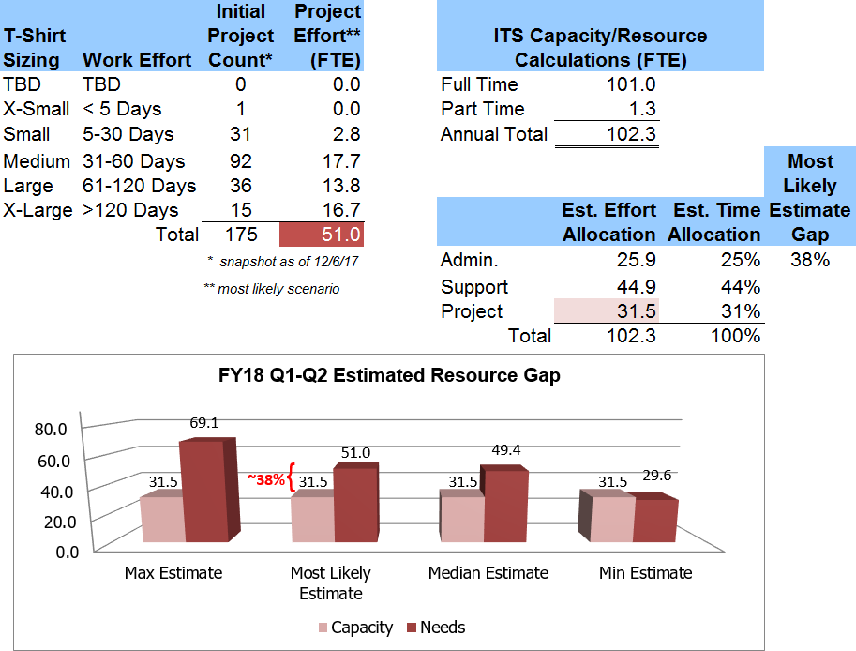
Capacity Estimates
15

Slide 16
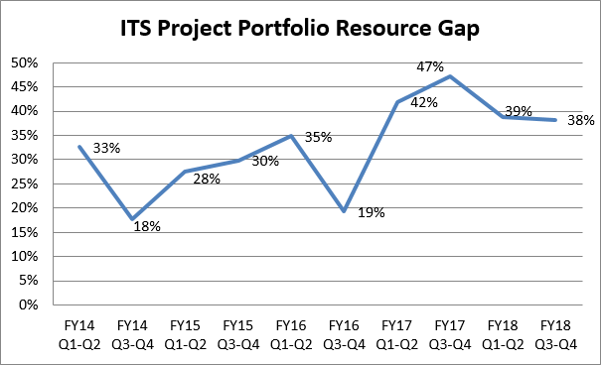
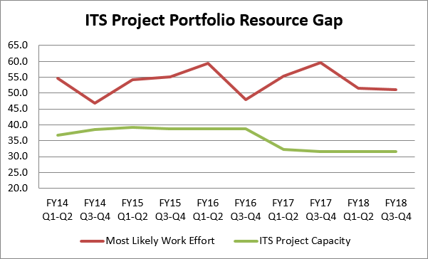
Portfolio Growth Details
16

Slide 17
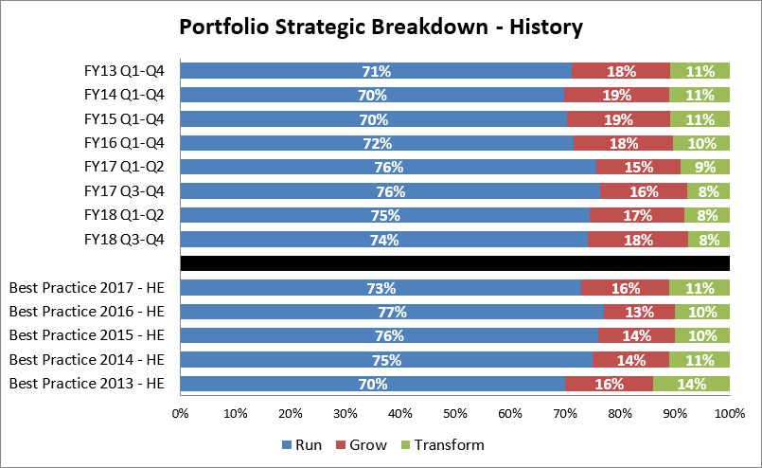
ITS Project Portfolio Impact
Run – Ongoing operations
Grow – Information systems and services to optimize performance
Transform – New technologies and processes that fundamentally promote change
17

Slide 18
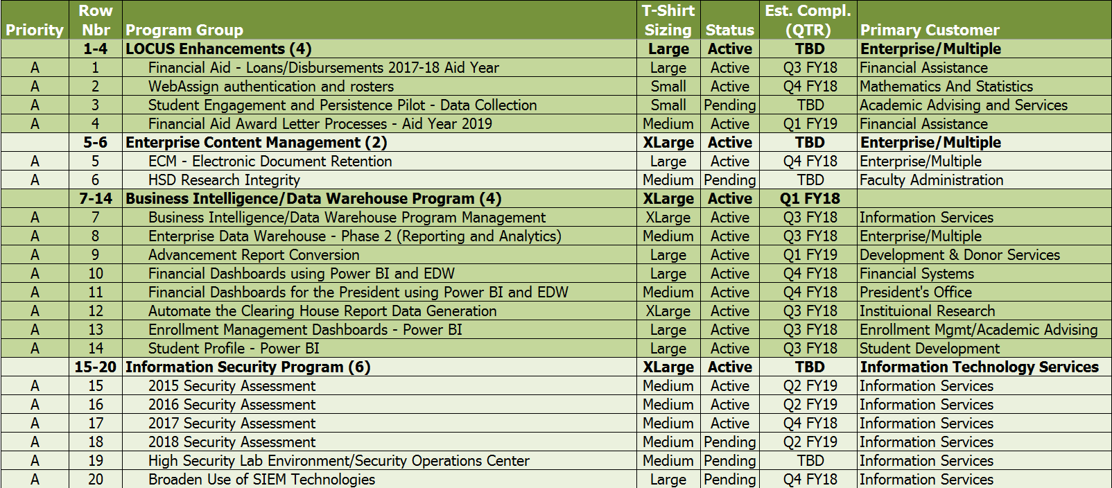
FY18 Q3-Q4 ITS Pre-Approved/Established Projects
18

Slide 19
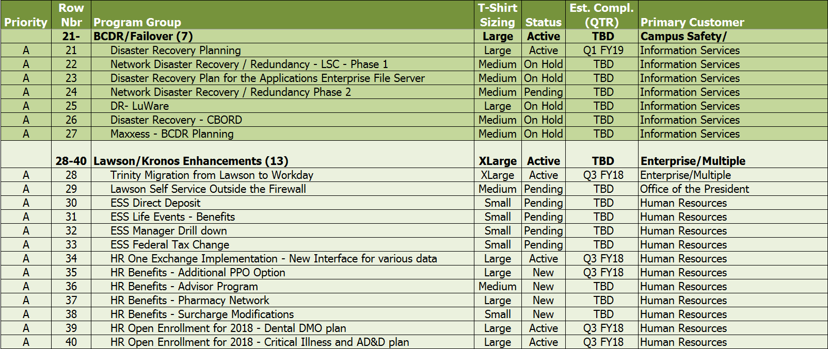
FY18 Q3-Q4 ITS Pre-Approved/Established Projects
19

Slide 20
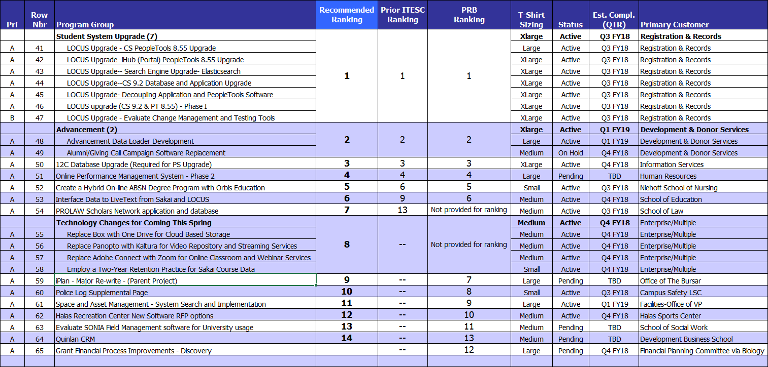
Draft
FY18 Q1-Q2 ITS Project Prioritization Worksheet
Draft
20

Slide 21
2018 ITESC Schedule
February 6, 2018 - Tuesday, 1:00-3:00 PM
March 22, 2018 - Tuesday, 1:00-3:00 PM
May 1, 2018 - Tuesday, 1:00-3:00 PM
June 21, 2018 - Thursday, 10:00-12:00 PM
Project Portfolio Prioritization
August 23, 2018 - Tuesday, 1:00-3:00 PM
September 18, 2018 - Tuesday, 1:00-3:00 PM
October 25, 2018 - Tuesday, 1:00-3:00 PM
December11, 2018 - Tuesday, 1:00-3:00 PM
Project Portfolio Prioritization
21

